Slide 1

Quantum Algorithm as a PDE Solver for Computational Fluid Dynamics (CFD)
Wiser Quantum Project
1. Problem Statement and Overview of the Project
2. Project Objectives and Approaches
3. Results and Impact
4. Future Scope
Name Of the Participant: Sajib Halder
Wiser ID: gst-bDwu8WDOuIWEGh3
Team Name: Quevian’s Paper Boat

Slide 2
Problem Statement and Overview of the Project
Wiser Quantum Project
Problem Statement:
Quantum Computing as a PDE Solver for Computational Fluid Dynamics(CFD)
Overview of the Project:
Imagine we are trying to simulate how air flows over an airplane wing or how water moves through a pipe. This is dealt with by applying Computational Fluid Dynamics (CFD), an area that is significantly dependent on the solution of Partial Differential Equations (PDEs). And we know these equations increase exponentially in complexity with size. That is where quantum computing enters the picture.
One such equation is called the Burgers' Equation. It is a simplified version of more complex fluid equations, but still useful for testing.
In this challenge, we aimed to build a quantum-enhanced PDE solver for Computational Fluid Dynamics (CFD).

Slide 3
Project Objectives and Approaches
Wiser Quantum Project
Project Objectives:
As we aimed to build a quantum-enhanced PDE solver for CFD, our focus was to build the same on our local system and later on a real QPU via two state-of-the-art frameworks: QTN (Quantum Tensor Network) and HSE (Hydrodynamic Schrödinger Equation).
Chosen Framework and Approaches:
QTN (Quantum Tensor‑Network): It is a method where a complex and high-dimensional fluid velocity data is broken down into simpler components using matrix product states (MPS) - pretty much shrinking enormous datasets onto a handful of qubits to simulate efficiently.
HSE (Hydrodynamic Schrödinger Equation): In HSE, the dynamics of fluid flow are described using a quantum wave-function, namely the Schrödinger Equation, to model fluid development.
Tools and Techniques:
PennyLane, Amazon Braket - Rigetti Quantum Processing Unit (QPU), Python.

Slide 4
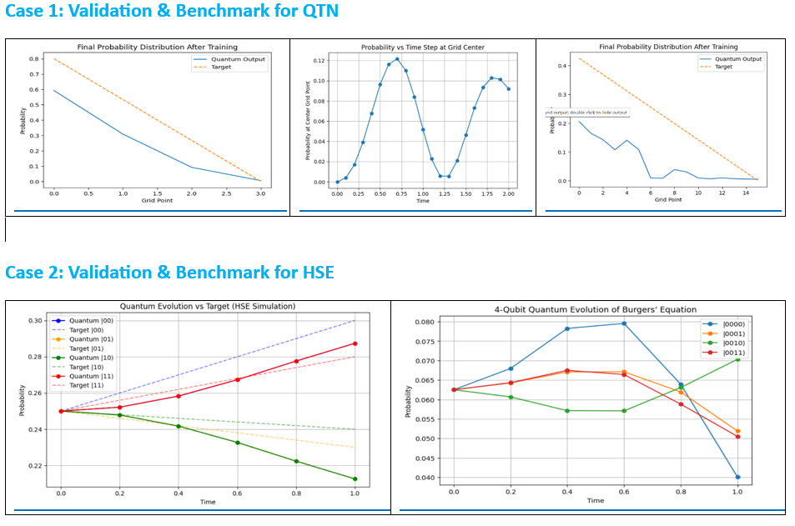
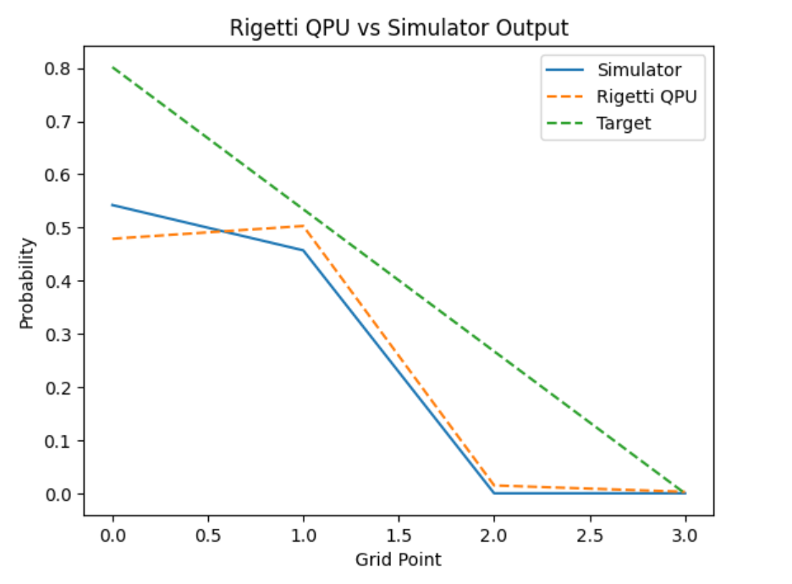
Results and Impact
Wiser Quantum Project
We meet our project goals:
After doing lots of experiments, validating QTN and HSE on both simulators and the real QPU, we effectively achieved our project objectives and met our project goals. Images below are described as follows:

Slide 5
Future Scope
Wiser Quantum Project
Some future scopes that we identified are as follows:
Hybrid QTN-HSE approach - To combine the strengths of both methods to enhance the accuracy and efficiency.
Limited Qubit resources - Overcome current hardware constraints to simulate larger systems.
Noise in QPU run - Reduce quantum hardware errors for more reliable outputs.
Advanced noise mitigation and optimized quantum algorithms - We can apply cutting-edge error correction(e.g., ZNE) and algorithmic improvements for better performance.
Thank you!

